Slide 1
SC1004 Part 2
Lectured by Prof Guan Cuntai
(teaching materials by Prof Chng Eng Siong)
Email: ctguan@ntu.edu.sg

Slide 2
Quiz 2 and Exam:
Quiz 2
- Coverage : Ch 6 ,7, 8 - Time/Date: Week 13, last lecture time (10:30-11.20am, 17th April 2024)
2. Final Exam
- Coverage : Ch 6, 7, 8 (Q3 & Q4)
- Date/Time: 2 May 2024 (Thursday), 1.00-3.00pm
(Ch 9 will not be tested)

Slide 3
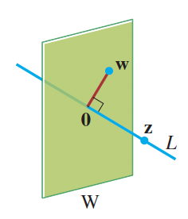
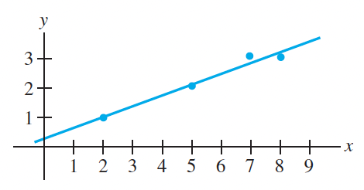
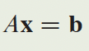
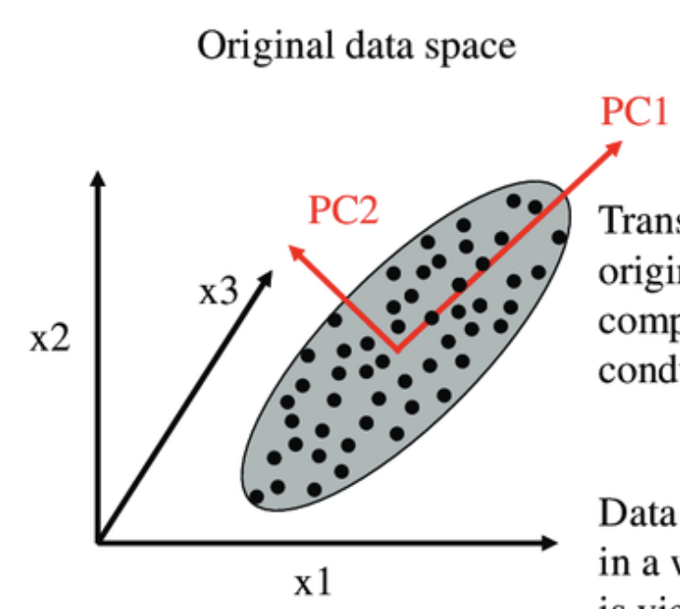
Syllabus for Part 2
Chapter | Topics | Week (Lecture) | Week (Tut)
6 | Orthogonality | 8-9 | 9-10
7 | Least Squares | 9-10 | 10-11
8 | EigenValue and Eigenvectors | 11-12 | 12-13
9 | Singular Value Decomposition (SVD) | 13
Table 1: schedule

Slide 4
Online Video learning Schedule
https://www.youtube.com/channel/UCBzG5jg3huxiPkCt-Serrjw
Week | Part | Topic | Notes
8 | 6.1.1-6.2.3 | Orthogonality, Normalization, Dot-Product, Inequalities, | Lecture 1: 6.1.1 - 6.1.3 Lecture 2: 6.1.4 - 6.2.3
9 | 6.2.4-6.3.2 | Orthogonal/Orthonormal Sets, Basis, Gram Schmidt and QR Decomposition | Lecture 3: 6.2.4 Lecture 4: 6.2.5 – 6.3.2
10 | 7.1.1-7.2.1 | Least Squares and Normal Eqn, Projection Matrix, Applications | Lecture 5: 7.1.1 – 7.1.3 Lecture 6: 7.1.4 – 7.2.1
11 | 8.1.1-8.1.2 | Eigenvectors, Eigen-values, Characteristics Eqn | Lecture 7: 8.1.1 Lecture 8: 8.1.2
12 | 8.1.3-8.1.5 | Diagonalisation, Power of A, Change of basis | Lecture 9: 8.1.3 Lecture 10: 8.1.4 – 8.1.5
13 | 9.1.1-9.2 | Introduction to SVD and PCA (Not examined in quiz/exam) | Lecture 11: 9.1.1 – 9.2 Lecture 12: Quiz 2

Slide 5
How will we conduct the course?
Before the lectures, watch the videos according to the schedule in Table 1
You can watch past years zoom video recordings at
https://www.youtube.com/@linearalgebra1884/playlists?view=50&sort=dd&shelf_id=2
During lecture hours –
We will summarize the lectures and highlight the key points
Q&A.

Slide 6
References

Slide 7
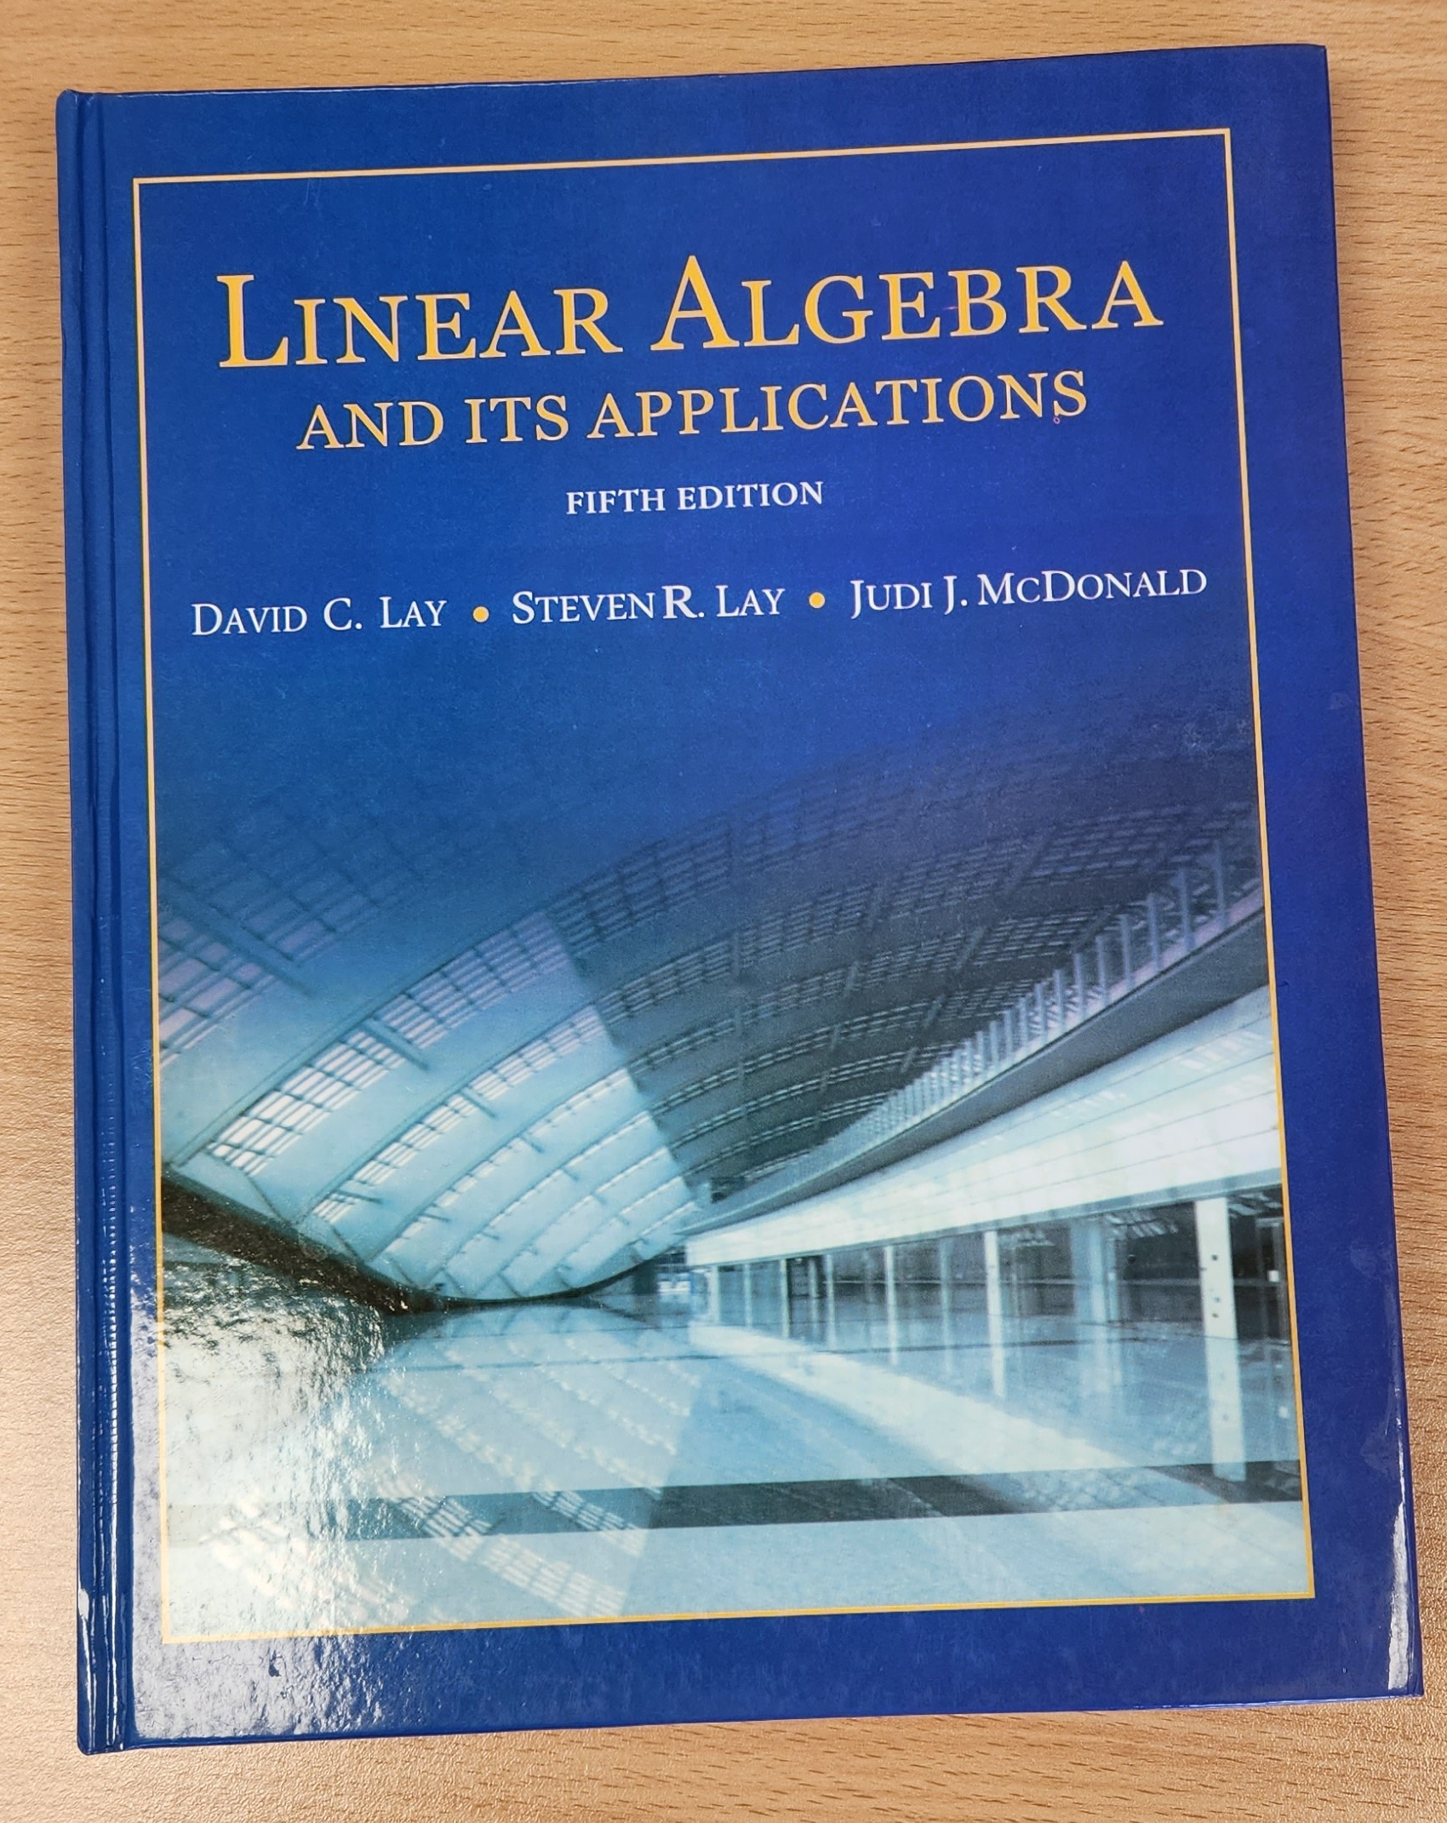

3Blue1Brown on YouTube
https://www.youtube.com/playlist?list=PLZHQObOWTQDPD3MizzM2xVFitgF8hE_ab
Linear Algebra and Its Applications
by David Lay, Steven Lay, Judi McDonald

Slide 8
Lecture (Week 9) (Chapter 6.2.3- 6.3.3)

Slide 9
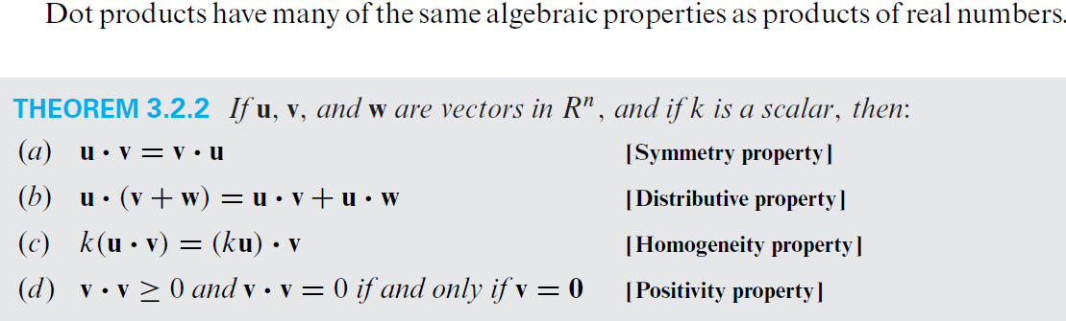
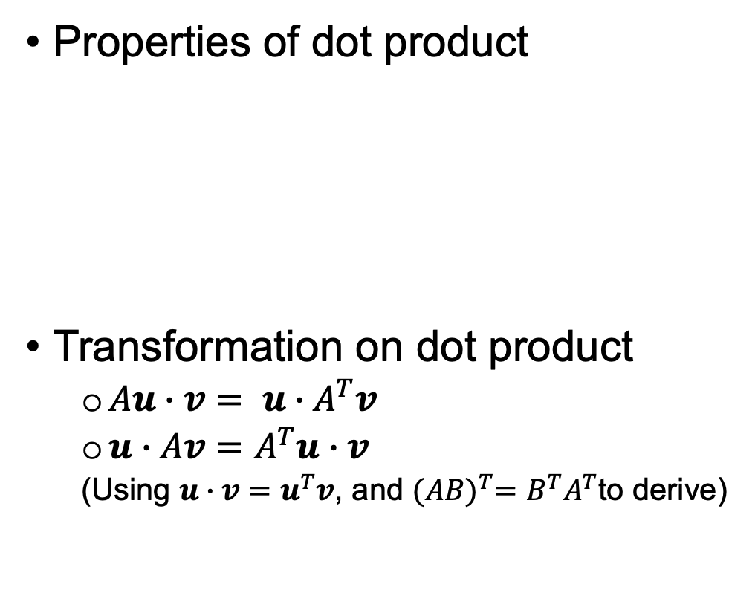
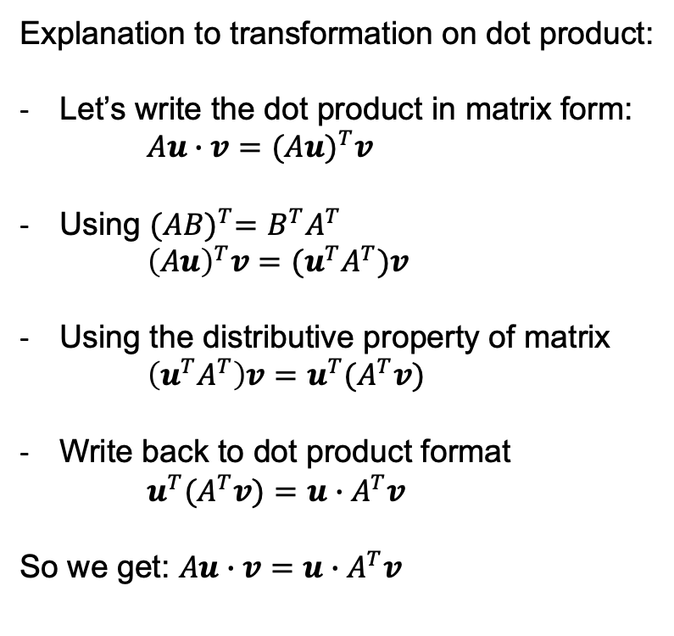
Key points – 6.1.3 Dot Product/Inner Product (2)
Revision
Properties of dot product
Transformation on dot product
$Au∙v= u∙A^{T}v$
$u∙Av=A^{T}u∙v$
(Using $u∙v=u^{T}v$, and ${(AB)}^{T}=B^{T}A^{T}$to derive)
Explanation to transformation on dot product:
Let’s write the dot product in matrix form:
$Au∙v={(Au)}^{T}v$
Using ${(AB)}^{T}=B^{T}A^{T}$
${\left(Au\right)}^{T}v=(u^{T}A^{T})v$
Using the distributive property of matrix
$\left(u^{T}A^{T}\right)v=u^{T}{(A}^{T}v)$
Write back to dot product format
$u^{T}{(A}^{T}v)=u∙A^{T}v$
So we get: $Au∙v=u∙A^{T}v$

Slide 10
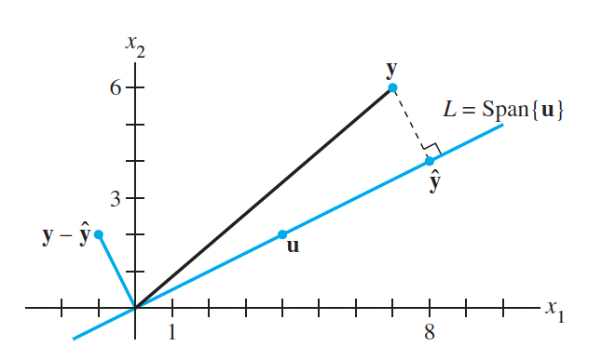
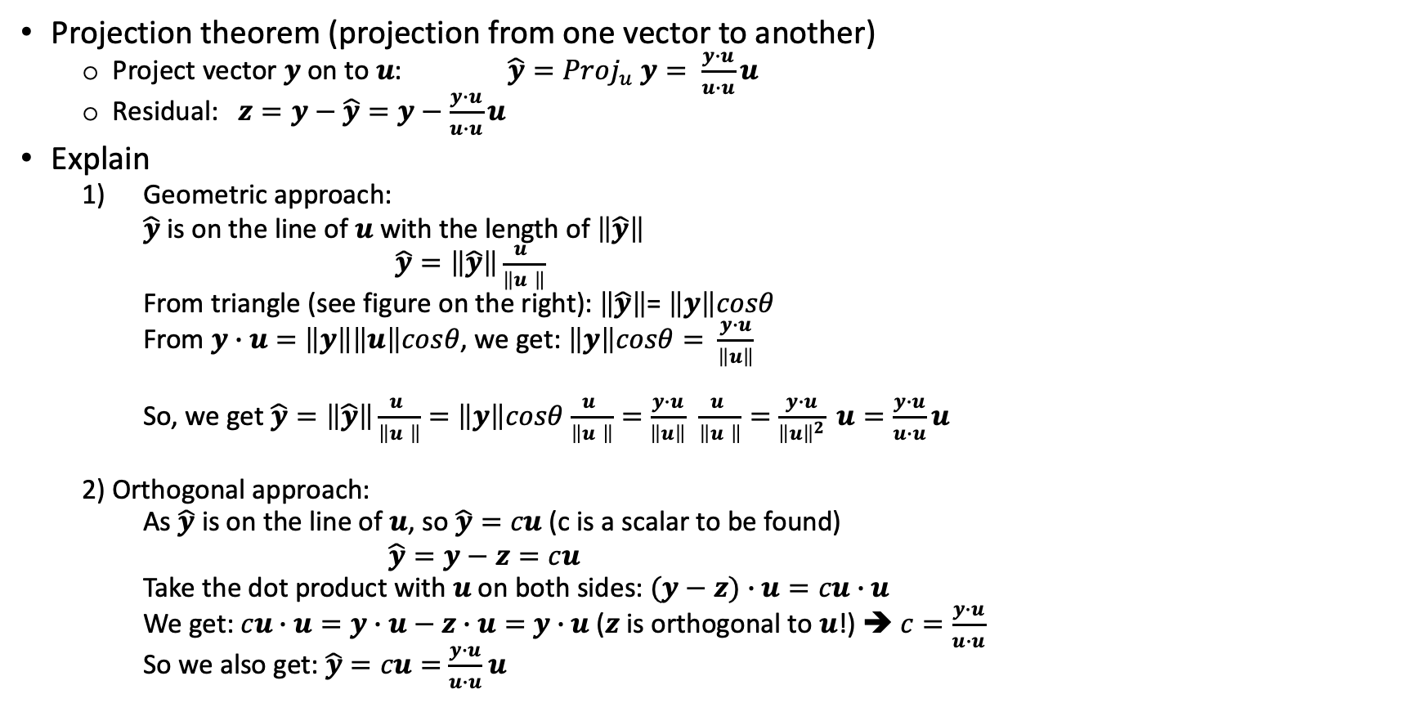

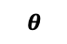
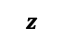
Key points – 6.2.2 Orthogonal Projection
Revision
Project $y=\left[\begin{matrix}7 \\ 6\end{matrix}\right]$ onto vector $u=\left[\begin{matrix}2 \\ 1\end{matrix}\right]$, and sketch $\hat{y}$.
Projection theorem (projection from one vector to another)
Project vector $y$ on to $u$: ${\hat{y}=Proj}_{u} y= \frac{y∙u}{u∙u}u$
Residual: $z=y−\hat{y}=y−\frac{y∙u}{u∙u}u$
Explain
Geometric approach:
$\hat{y}$ is on the line of $u$ with the length of $\left\|\hat{y}\right\|$
$\hat{y}=\left\|\hat{y}\right\|\frac{u }{\left\|u \right\|}$
From triangle (see figure on the right): $\left\|\hat{y}\right\|$= $\left\|y\right\|cosθ$
From $y∙u=$ $\left\|y\right\|\left\|u\right\|cosθ$, we get: $\left\|y\right\|cosθ=$ $\frac{y∙u}{\left\|u\right\|}$
So, we get $\hat{y}=\left\|\hat{y}\right\|\frac{u }{\left\|u \right\|}=$ $\left\|y\right\|cosθ$ $\frac{u }{\left\|u \right\|}=$ $\frac{y∙u}{\left\|u\right\|}$ $\frac{u }{\left\|u \right\|}=$ $\frac{y∙u}{{\left\|u\right\|}^{2}} u=\frac{y∙u}{u∙u}u$
2) Orthogonal approach:
As $\hat{y}$ is on the line of $u$, so $\hat{y}=cu$ (c is a scalar to be found)
$\hat{y}=y−z=cu$
Take the dot product with $u$ on both sides: $(y−z)∙u=cu∙u$
We get: $cu∙u=y∙u−z∙u=$ $y∙u$ ($z$ is orthogonal to $u$!) ➔ $c=\frac{y∙u}{u∙u}$
So we also get: $\hat{y}=cu=$ $\frac{y∙u}{u∙u}$ $u$
$$z$$
$$θ$$

Slide 11
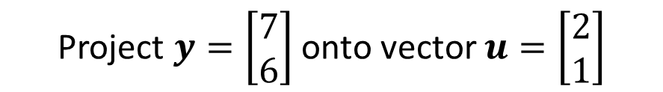
Example
Project $y=\left[\begin{matrix}7 \\ 6\end{matrix}\right]$ onto vector $u=\left[\begin{matrix}2 \\ 1\end{matrix}\right]$
$$z$$

Slide 12
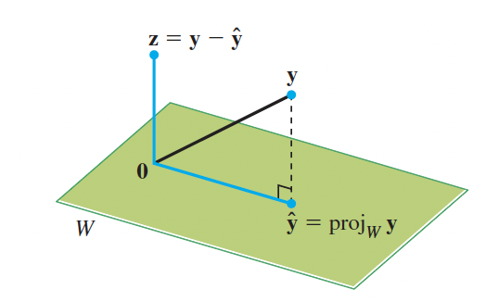
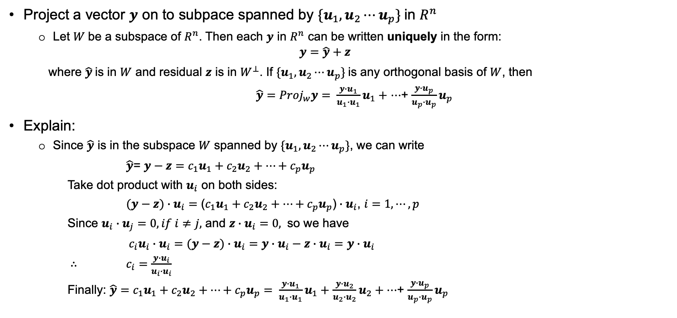
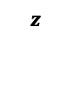
Key points – 6.2.3 Orthogonal Decomposition
Revision
Project a vector $y$ on to subpace spanned by ${\{u}_{1},u_{2}⋯u_{p}\}$in $R^{n}$
Let $W$be a subspace of $R^{n}$. Then each $y$ in $R^{n}$ can be written uniquely in the form:
$$y=\hat{y}+z$$
where $\hat{y}$is in $W$ and residual $z$ is in $W^{⊥}$. If ${\{u}_{1},u_{2}⋯u_{p}\}$is any orthogonal basis of $W$, then
${\hat{y}=Proj}_{w}y= \frac{y∙u_{1}}{u_{1}∙u_{1}}u_{1}+$ $⋯$+ $\frac{y∙u_{p}}{u_{p}∙u_{p}}u_{p}$
Explain:
Since $\hat{y}$ is in the subspace $W$ spanned by ${\{u}_{1},u_{2}⋯u_{p}\}$, we can write
$\hat{y}$= $y−z={c_{1}u}_{1}+{c_{2}u}_{2}+⋯+c_{p}u_{p}$
Take dot product with $u_{i}$ on both sides:
$(y−z)$ $∙u_{i}=$ (${c_{1}u}_{1}+{c_{2}u}_{2}+⋯+c_{p}u_{p}$) $∙u_{i}$, $i=1,⋯,p$
Since $u_{i}$ $∙u_{j}=0, if i≠j,$ and $z∙u_{i}=0,$ so we have
${c_{i}u}_{i}$ $∙u_{i}=$ $(y−z)$ $∙u_{i}=y∙u_{i}−z∙u_{i}=y∙u_{i}$
$∴$ $c_{i}=\frac{y∙u_{i}}{u_{i}∙u_{i}}$
Finally: $\hat{y}={c_{1}u}_{1}+{c_{2}u}_{2}+⋯+c_{p}u_{p}= \frac{y∙u_{1}}{u_{1}∙u_{1}}u_{1}+$ $\frac{y∙u_{2}}{u_{2}∙u_{2}}u_{2}+⋯$+ $\frac{y∙u_{p}}{u_{p}∙u_{p}}u_{p}$
$$z$$

Slide 13
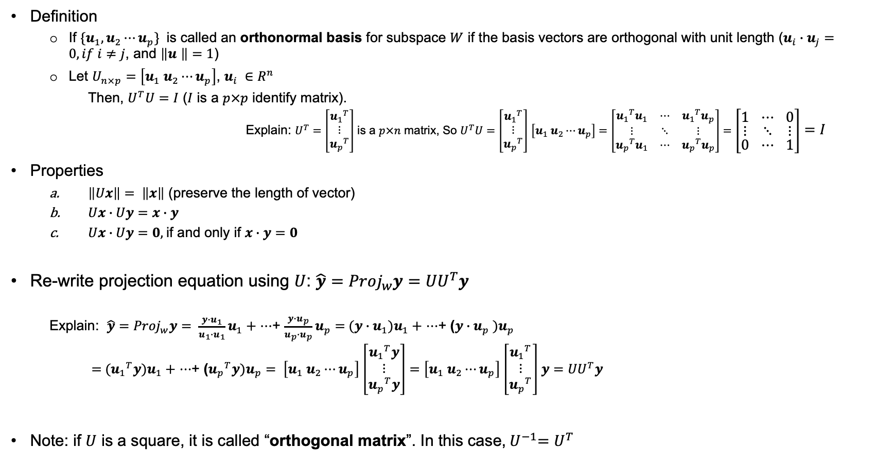
Key points – 6.2.4 Orthonormal Sets
Definition
If ${\{u}_{1},u_{2}⋯u_{p}\}$ is called an orthonormal basis for subspace $W$ if the basis vectors are orthogonal with unit length ($u_{i}∙u_{j}=0, if i≠j$, and $\left\|u \right\|=1$)
Let $U_{n×p}=\left[u_{1} u_{2}⋯u_{p}\right]$, $u_{i} ∈$ $R^{n}$
Then, $U^{T}U=I$ ($I$ is a $p×p$ identify matrix).
Explain: $U^{T}=\left[\begin{matrix}{u_{1}}^{T} \\ ⋮ \\ {u_{p}}^{T}\end{matrix}\right]$ is a $p×n$ matrix, So $U^{T}U=$ $\left[\begin{matrix}{u_{1}}^{T} \\ ⋮ \\ {u_{p}}^{T}\end{matrix}\right]$ $\left[u_{1} u_{2}⋯u_{p}\right]=\left[\begin{matrix}{u_{1}}^{T}u_{1} & ⋯ & {u_{1}}^{T}u_{p} \\ ⋮ & ⋱ & ⋮ \\ {u_{p}}^{T}u_{1} & ⋯ & {u_{p}}^{T}u_{p}\end{matrix}\right]=\left[\begin{matrix}1 & ⋯ & 0 \\ ⋮ & ⋱ & ⋮ \\ 0 & ⋯ & 1\end{matrix}\right]=I$
Properties
$\left\|Ux\right\|= \left\|x\right\|$ (preserve the length of vector)
$Ux∙$ $Uy=x∙$ $y$
$Ux∙$ $Uy=0,$if and only if $x∙$ $y=0$
Re-write projection equation using $U$: ${{\hat{y}=Proj}_{w}y=UU}^{T}y$
Explain: ${\hat{y}=Proj}_{w}y= \frac{y∙u_{1}}{u_{1}∙u_{1}}u_{1}+$ $⋯$+ $\frac{y∙u_{p}}{u_{p}∙u_{p}}u_{p}=$ $(y∙u_{1})u_{1}+$ $⋯$+ ($y∙u_{p} )u_{p}$
$=$ $({u_{1}}^{T}y)u_{1}+$ $⋯$+ (${u_{p}}^{T}y)u_{p}= \left[u_{1} u_{2}⋯u_{p}\right]$ $\left[\begin{matrix}{u_{1}}^{T}y \\ ⋮ \\ {u_{p}}^{T}y\end{matrix}\right]=$ $\left[u_{1} u_{2}⋯u_{p}\right]$ $\left[\begin{matrix}{u_{1}}^{T} \\ ⋮ \\ {u_{p}}^{T}\end{matrix}\right]$ $y={UU}^{T}y$
Note: if $U$ is a square, it is called “orthogonal matrix”. In this case,${ U}^{−1}=U^{T}$

Slide 14
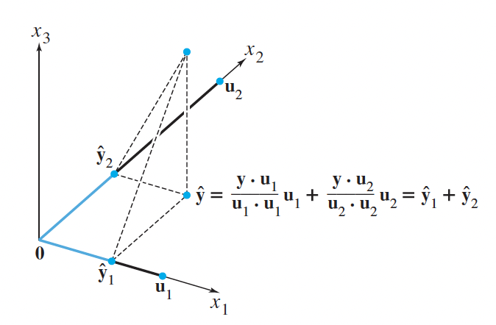
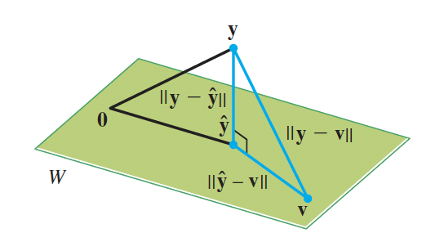
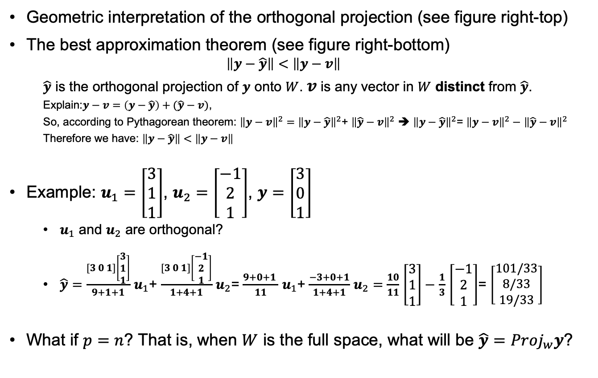
Key points – 6.2.5 Orthogonal Decomposition.
Geometric interpretation of the orthogonal projection (see figure right-top)
The best approximation theorem (see figure right-bottom)
$$\left\|y−\hat{y}\right\|<\left\|y−v\right\|$$
$\hat{y}$ is the orthogonal projection of $y$ onto $W$. $v$ is any vector in $W$ distinct from $\hat{y}$.
Explain:$y−v=\left(y−\hat{y}\right)+(\hat{y}−v)$,
So, according to Pythagorean theorem: ${\left\|y−v\right\|}^{2}=$ ${\left\|y−\hat{y}\right\|}^{2}$+ ${\left\|\hat{y}−v\right\|}^{2}$ ➔ ${\left\|y−\hat{y}\right\|}^{2}$= ${\left\|y−v\right\|}^{2}−$ ${\left\|\hat{y}−v\right\|}^{2}$
Therefore we have: $\left\|y−\hat{y}\right\|<\left\|y−v\right\|$
Example: $u_{1}=\left[\begin{matrix}3 \\ 1 \\ 1\end{matrix}\right]$, $u_{2}=\left[\begin{matrix}−1 \\ 2 \\ 1\end{matrix}\right]$, $y=\left[\begin{matrix}3 \\ 0 \\ 1\end{matrix}\right]$
$u_{1}$ and $u_{2}$ are orthogonal?
$\hat{y}=\frac{[3 0 1]\left[\begin{matrix}3 \\ 1 \\ 1\end{matrix}\right]}{9+1+1}$ $u_{1}$+ $\frac{[3 0 1]\left[\begin{matrix}−1 \\ 2 \\ 1\end{matrix}\right]}{1+4+1}$ $u_{2}$= $\frac{9+0+1 }{11}$ $u_{1}$+ $\frac{−3+0+1}{1+4+1}$ $u_{2}=$ $\frac{10}{11}$ $\left[\begin{matrix}3 \\ 1 \\ 1\end{matrix}\right]−$ $\frac{1}{3}$ $\left[\begin{matrix}−1 \\ 2 \\ 1\end{matrix}\right]$= $\left[\begin{matrix}101/33 \\ 8/33 \\ 19/33\end{matrix}\right]$
What if $p=n$? That is, when $W$ is the full space, what will be ${\hat{y}=Proj}_{w}y$?

Slide 15
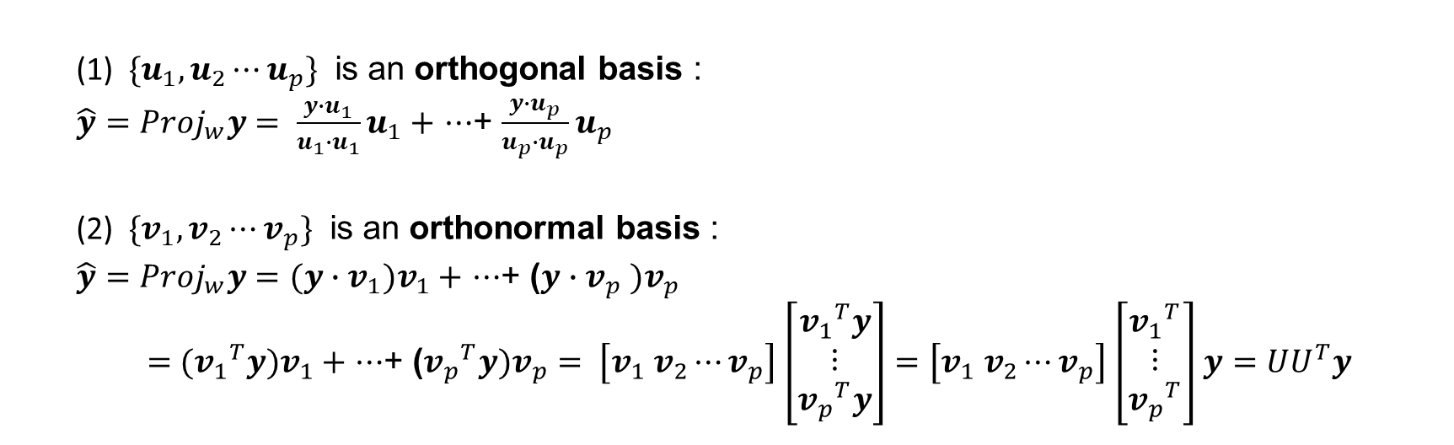
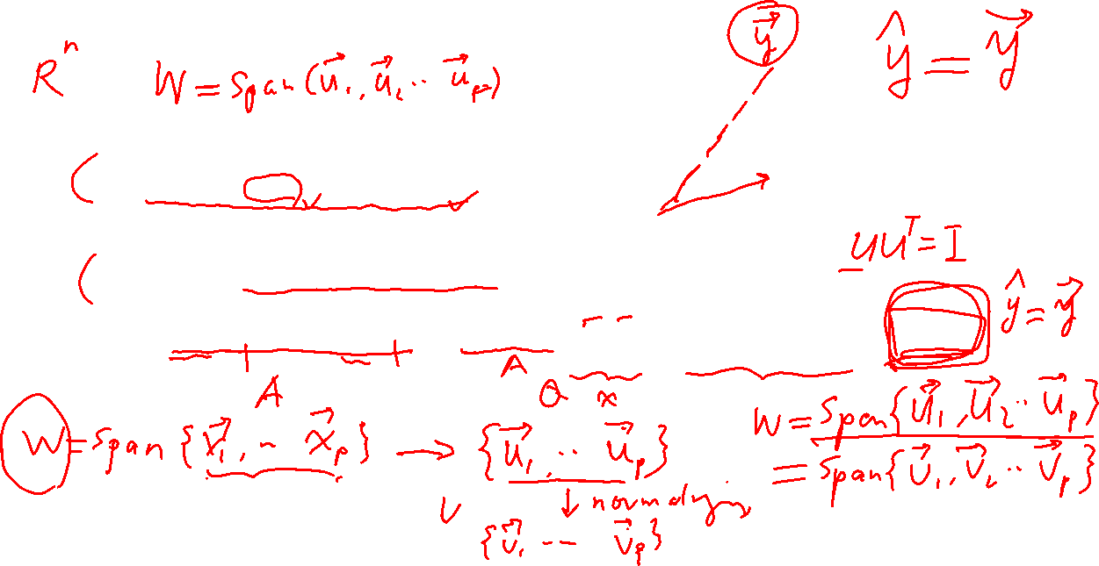
(1) ${\{u}_{1},u_{2}⋯u_{p}\}$ is an orthogonal basis :
${\hat{y}=Proj}_{w}y= \frac{y∙u_{1}}{u_{1}∙u_{1}}u_{1}+$ $⋯$+ $\frac{y∙u_{p}}{u_{p}∙u_{p}}u_{p}$
(2) ${\{v}_{1},v_{2}⋯v_{p}\}$ is an orthonormal basis :
${\hat{y}=Proj}_{w}y=(y∙v_{1})v_{1}+$ $⋯$+ ($y∙v_{p} )v_{p}$
$=$ $({v_{1}}^{T}y)v_{1}+$ $⋯$+ (${v_{p}}^{T}y)v_{p}= \left[v_{1} v_{2}⋯v_{p}\right]$ $\left[\begin{matrix}{v_{1}}^{T}y \\ ⋮ \\ {v_{p}}^{T}y\end{matrix}\right]=$ $\left[v_{1} v_{2}⋯v_{p}\right]$ $\left[\begin{matrix}{v_{1}}^{T} \\ ⋮ \\ {v_{p}}^{T}\end{matrix}\right]$ $y={UU}^{T}y$

Slide 16
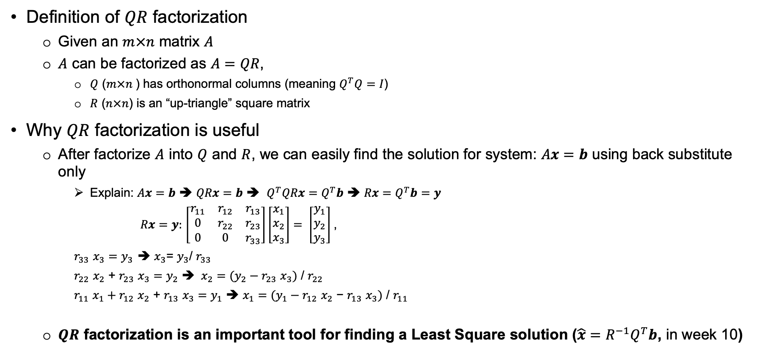
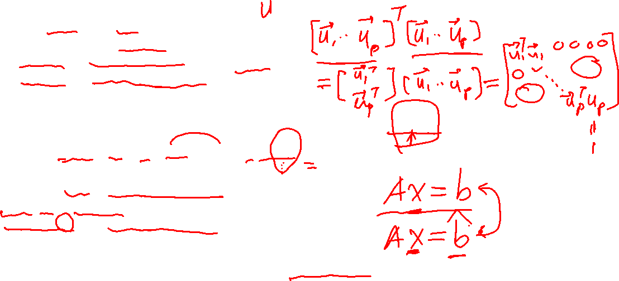
Key points – 6.3.1 QR Factorization (why)
Definition of $QR$ factorization
Given an $m×n$ matrix $A$
$A$ can be factorized as $A=QR$,
$Q$ ($m×n$) has orthonormal columns (meaning $Q^{T}Q=I$)
$R$ ($n×n$) is an “up-triangle” square matrix
Why $QR$ factorization is useful
After factorize $A$ into $Q$ and $R$, we can easily find the solution for system: $Ax=b$ using back substitute only
Explain: $Ax=b$ ➔ $QRx=b$ ➔ $Q^{T}QRx=Q^{T}b$ ➔ $Rx=Q^{T}b=y$
$Rx=y:$ $\left[\begin{matrix}r_{11} & r_{12} & r_{13} \\ 0 & r_{22} & r_{23} \\ 0 & 0 & r_{33}\end{matrix}\right]\left[\begin{matrix}x_{1} \\ x_{2} \\ x_{3}\end{matrix}\right]= \left[\begin{matrix}y_{1} \\ y_{2} \\ y_{3}\end{matrix}\right]$,
$r_{33}$ $x_{3}=y_{3}$ ➔ $x_{3}$= $y_{3}$/ $r_{33}$
$r_{22}$ $x_{2}$ + $r_{23}$ $x_{3}=$ $y_{2}$ ➔ $x_{2}=(y_{2}−r_{23} x_{3})$ / $r_{22}$
$r_{11} x_{1}+r_{12}$ $x_{2}$ + $r_{13}$ $x_{3}=$ $y_{1}$ ➔ $x_{1}=(y_{1}−r_{12} x_{2} \text{−} r_{13} x_{3})\text{ /} r_{11}$
$QR$ factorization is an important tool for finding a Least Square solution ($\hat{x}=R^{−1}Q^{T}b$, in week 10)

Slide 17
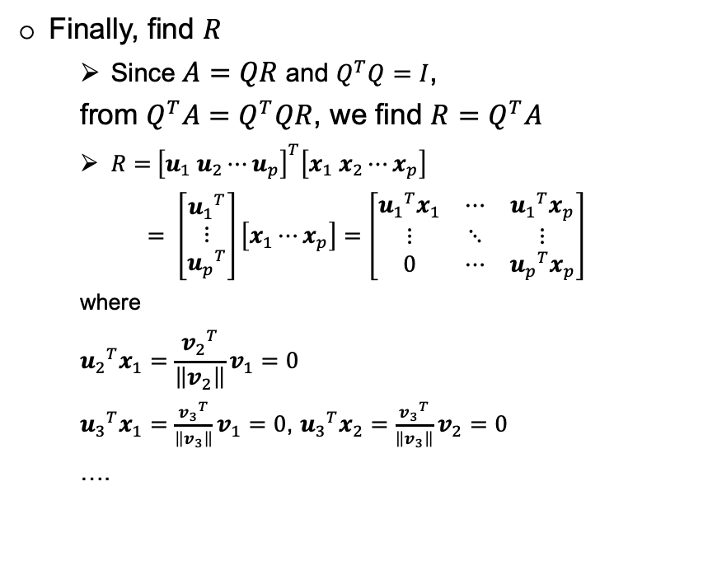
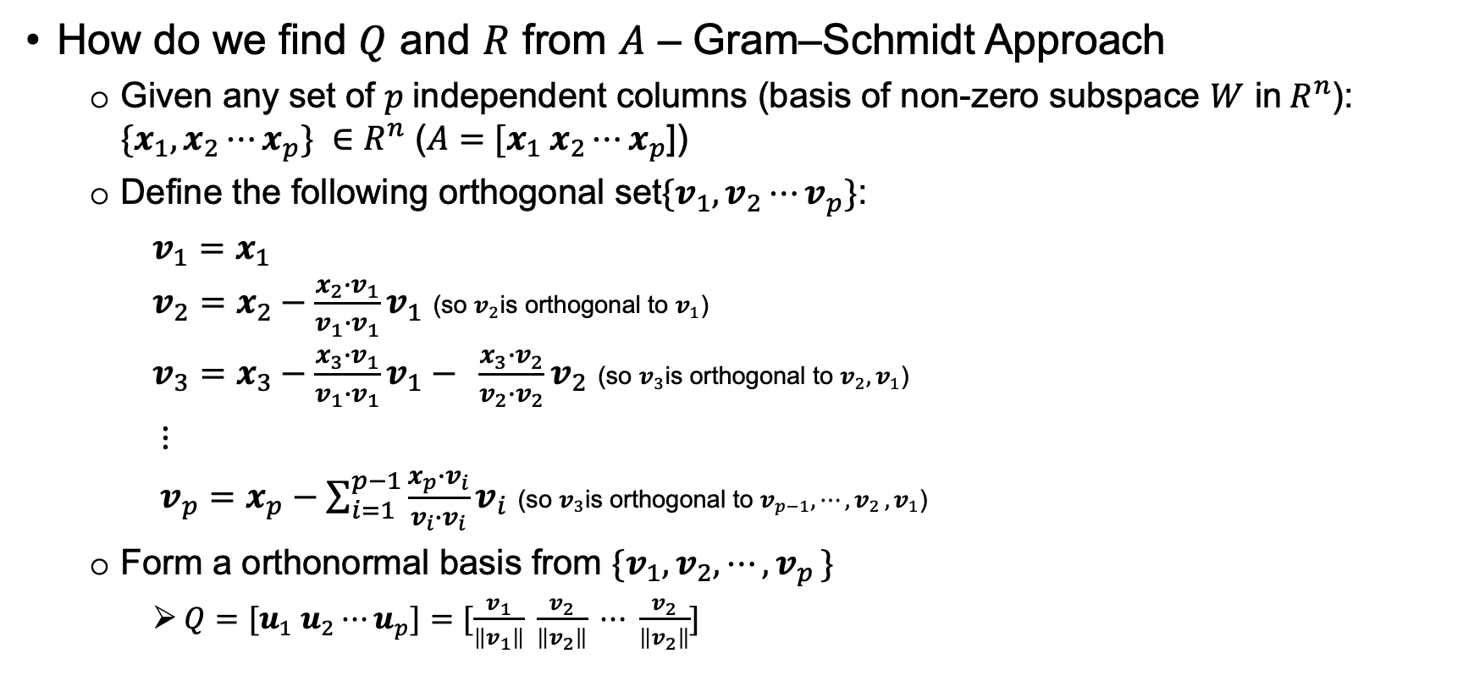
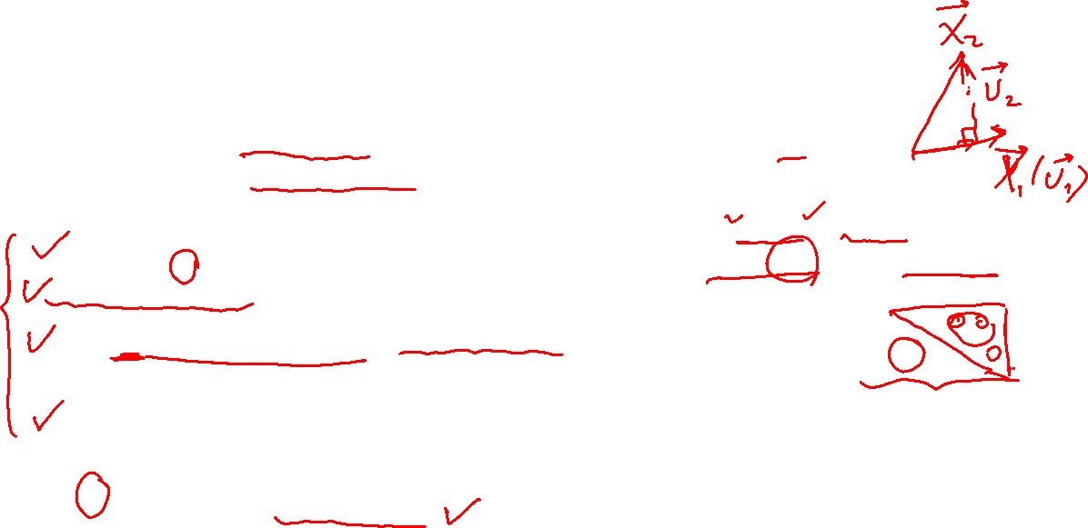
Key points – 6.3.2 QR Factorization (how)
How do we find $Q$ and $R$ from $A$ – Gram–Schmidt Approach
Given any set of $p$independent columns (basis of non-zero subspace $W$ in$R^{n}$): ${\{x}_{1},x_{2}⋯x_{p}\} ∈$ $R^{n}$ ($A=$ ${[x}_{1} x_{2}⋯x_{p}$])
Define the following orthogonal set${\{v}_{1},v_{2}⋯v_{p}\}$:
$v_{1}=x_{1}$
$v_{2}=x_{2}−$ $\frac{x_{2}∙v_{1}}{v_{1}∙v_{1}}v_{1}$ (so $v_{2}$is orthogonal to $v_{1}$)
$v_{3}=x_{3}−$ $\frac{x_{3}∙v_{1}}{v_{1}∙v_{1}}v_{1}− \frac{x_{3}∙v_{2}}{v_{2}∙v_{2}}v_{2}$ (so $v_{3}$is orthogonal to ${v_{2},v}_{1}$)
$⋮$
$v_{p}=x_{p}−$ $\sum_{i=1}^{p−1}{\frac{x_{p}∙v_{i}}{v_{i}∙v_{i}}v_{i}}$ (so $v_{3}$is orthogonal to ${v_{p−1}{,⋯,v}_{2},v}_{1}$)
Form a orthonormal basis from ${\{v}_{1},v_{2},⋯{,v}_{p}\}$
$Q={[u}_{1} u_{2}⋯u_{p}]=[\frac{v_{1}}{\left\|v_{1}\right\|} \frac{v_{2}}{\left\|v_{2}\right\|} ⋯ \frac{v_{2}}{\left\|v_{2}\right\|}]$
Finally, find $R$
Since $A=QR$ and $Q^{T}Q=I$,
from $Q^{T}A=Q^{T}QR$, we find $R=Q^{T}A$
$R=$ ${\left[u_{1} u_{2}⋯u_{p}\right]}^{T}\left[x_{1} x_{2}⋯x_{p}\right]$
$= \left[\begin{matrix}{u_{1}}^{T} \\ ⋮ \\ {u_{p}}^{T}\end{matrix}\right]\left[x_{1}⋯x_{p}\right]=\left[\begin{matrix}{u_{1}}^{T}x_{1} & ⋯ & {u_{1}}^{T}x_{p} \\ ⋮ & ⋱ & ⋮ \\ 0 & ⋯ & {u_{p}}^{T}x_{p}\end{matrix}\right]$
where
$${u_{2}}^{T}x_{1}=\frac{{v_{2}}^{T}}{\left\|v_{2}\right\|}v_{1}=0$$
${u_{3}}^{T}x_{1}=\frac{{v_{3}}^{T}}{\left\|v_{3}\right\|}v_{1}=0$, ${u_{3}}^{T}x_{2}=\frac{{v_{3}}^{T}}{\left\|v_{3}\right\|}v_{2}=0$
….

Slide 18
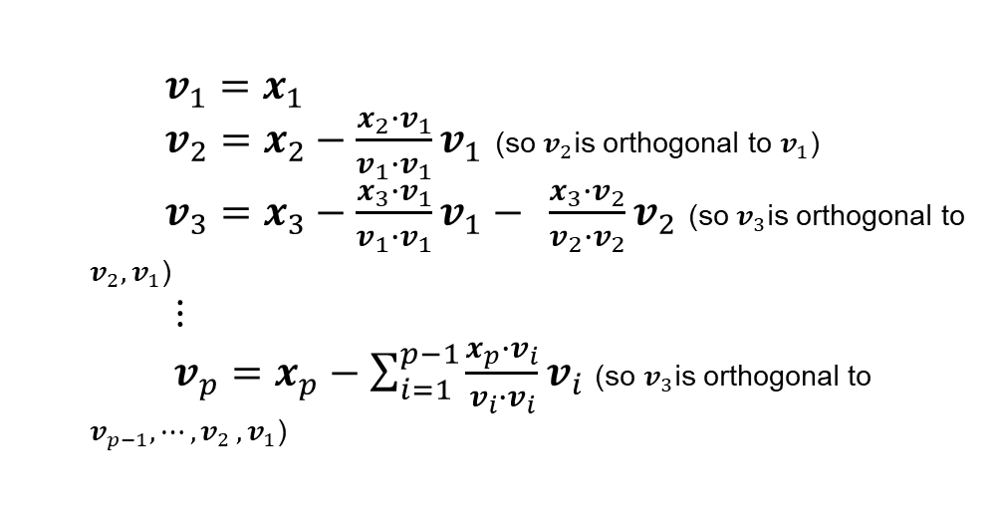
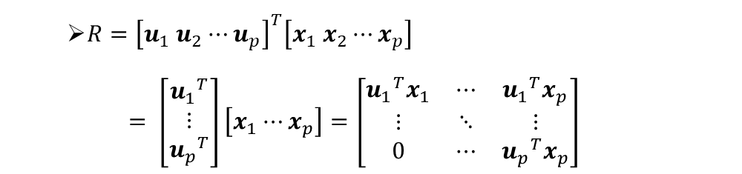
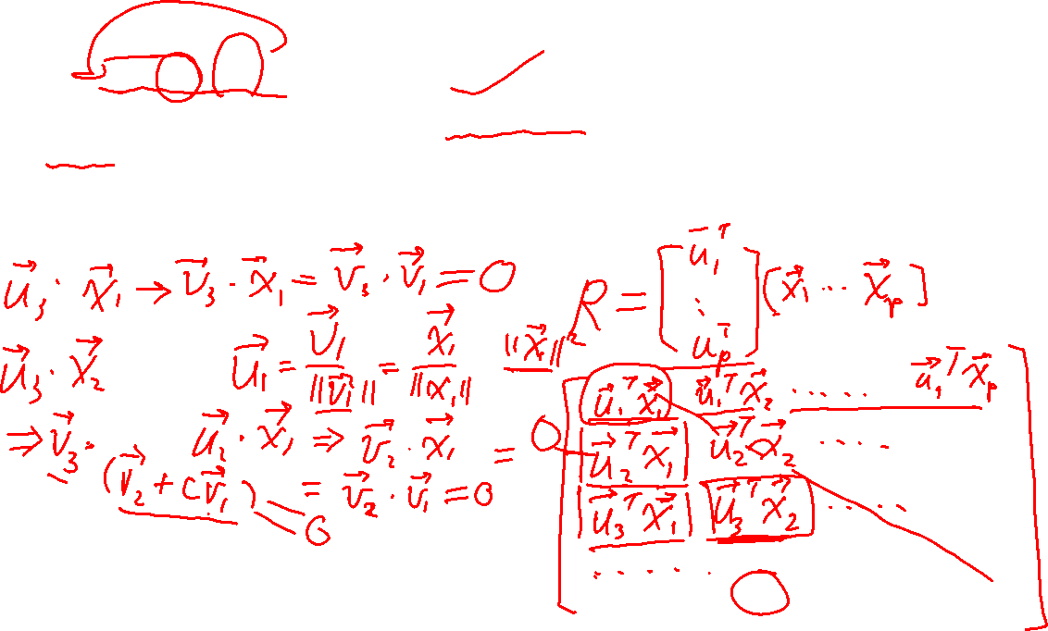
$v_{1}=x_{1}$
$v_{2}=x_{2}−$ $\frac{x_{2}∙v_{1}}{v_{1}∙v_{1}}v_{1}$ (so $v_{2}$is orthogonal to $v_{1}$)
$v_{3}=x_{3}−$ $\frac{x_{3}∙v_{1}}{v_{1}∙v_{1}}v_{1}− \frac{x_{3}∙v_{2}}{v_{2}∙v_{2}}v_{2}$ (so $v_{3}$is orthogonal to ${v_{2},v}_{1}$)
$⋮$
$v_{p}=x_{p}−$ $\sum_{i=1}^{p−1}{\frac{x_{p}∙v_{i}}{v_{i}∙v_{i}}v_{i}}$ (so $v_{3}$is orthogonal to ${v_{p−1}{,⋯,v}_{2},v}_{1}$)
$R=$ ${\left[u_{1} u_{2}⋯u_{p}\right]}^{T}\left[x_{1} x_{2}⋯x_{p}\right]$
$= \left[\begin{matrix}{u_{1}}^{T} \\ ⋮ \\ {u_{p}}^{T}\end{matrix}\right]\left[x_{1}⋯x_{p}\right]=\left[\begin{matrix}{u_{1}}^{T}x_{1} & ⋯ & {u_{1}}^{T}x_{p} \\ ⋮ & ⋱ & ⋮ \\ 0 & ⋯ & {u_{p}}^{T}x_{p}\end{matrix}\right]$

Slide 19
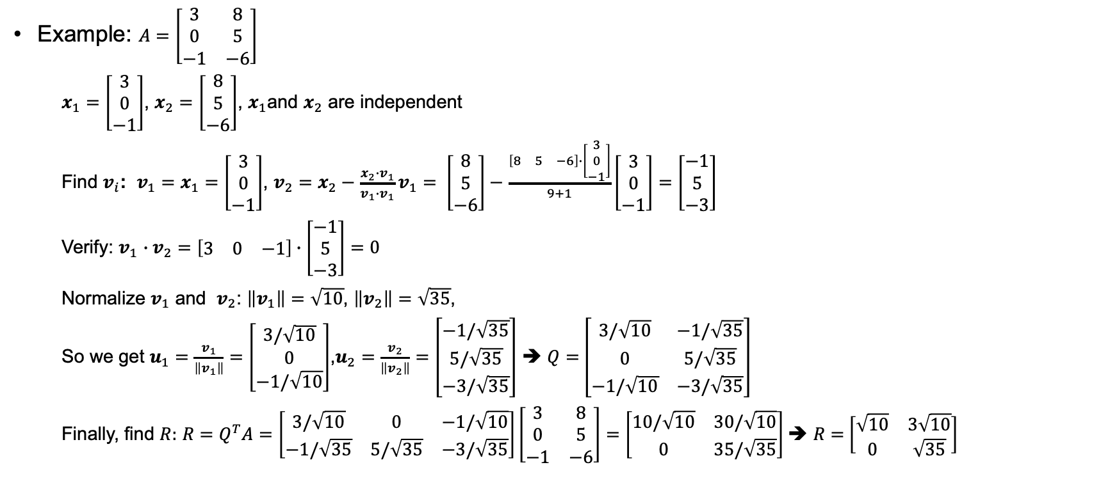
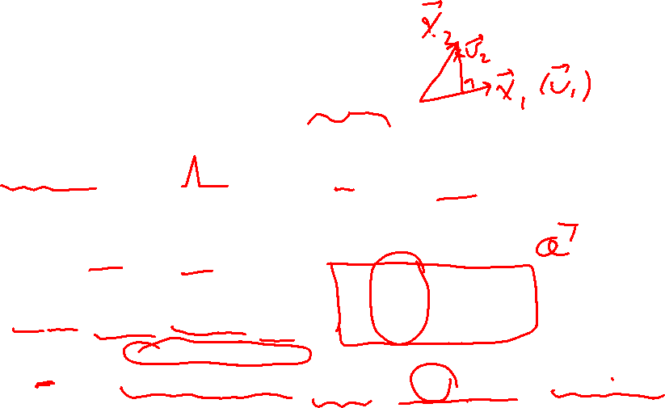
Key points – 6.3.2 QR Factorization (how)
Example: $A=\left[\begin{matrix}3 & 8 \\ 0 & 5 \\ −1 & −6\end{matrix}\right]$
$x_{1}=\left[\begin{matrix}3 \\ 0 \\ −1\end{matrix}\right]$, $x_{2}=\left[\begin{matrix}8 \\ 5 \\ −6\end{matrix}\right]$, $x_{1}$and $x_{2}$ are independent
Find $v_{i}$: $v_{1}=x_{1}=\left[\begin{matrix}3 \\ 0 \\ −1\end{matrix}\right]$, $v_{2}=$ $x_{2}−$ $\frac{x_{2}∙v_{1}}{v_{1}∙v_{1}}v_{1}= \left[\begin{matrix}8 \\ 5 \\ −6\end{matrix}\right]−$ $\frac{\left[\begin{matrix}8 & 5 & −6\end{matrix}\right]∙\left[\begin{matrix}3 \\ 0 \\ −1\end{matrix}\right]}{9+1}\left[\begin{matrix}3 \\ 0 \\ −1\end{matrix}\right]=$ $\left[\begin{matrix}−1 \\ 5 \\ −3\end{matrix}\right]$
Verify: $v_{1}$ $∙v_{2}=$ $\left[\begin{matrix}3 & 0 & −1\end{matrix}\right]∙\left[\begin{matrix}−1 \\ 5 \\ −3\end{matrix}\right]=0$
Normalize $v_{1}$ and $v_{2}$: $\left\|v_{1}\right\|=\sqrt{10}$, $\left\|v_{2}\right\|=\sqrt{35}$,
So we get $u_{1}=\frac{v_{1}}{\left\|v_{1}\right\|}=\left[\begin{matrix}3/\sqrt{10} \\ 0 \\ −1/\sqrt{10}\end{matrix}\right]$,$u_{2}=\frac{v_{2}}{\left\|v_{2}\right\|}=\left[\begin{matrix}−1/\sqrt{35} \\ 5/\sqrt{35} \\ −3/\sqrt{35}\end{matrix}\right]$ ➔ $Q=$ $\left[\begin{matrix}3/\sqrt{10} & −1/\sqrt{35} \\ 0 & 5/\sqrt{35} \\ −1/\sqrt{10} & −3/\sqrt{35}\end{matrix}\right]$
Finally, find $R:$ $R=Q^{T}A=\left[\begin{matrix}3/\sqrt{10} & 0 & −1/\sqrt{10} \\ −1/\sqrt{35} & 5/\sqrt{35} & −3/\sqrt{35}\end{matrix}\right]\left[\begin{matrix}3 & 8 \\ 0 & 5 \\ −1 & −6\end{matrix}\right]=\left[\begin{matrix}10/\sqrt{10} & 30/\sqrt{10} \\ 0 & 35/\sqrt{35}\end{matrix}\right]$ ➔ $R=$ $\left[\begin{matrix}\sqrt{10} & 3\sqrt{10} \\ 0 & \sqrt{35}\end{matrix}\right]$

Slide 20
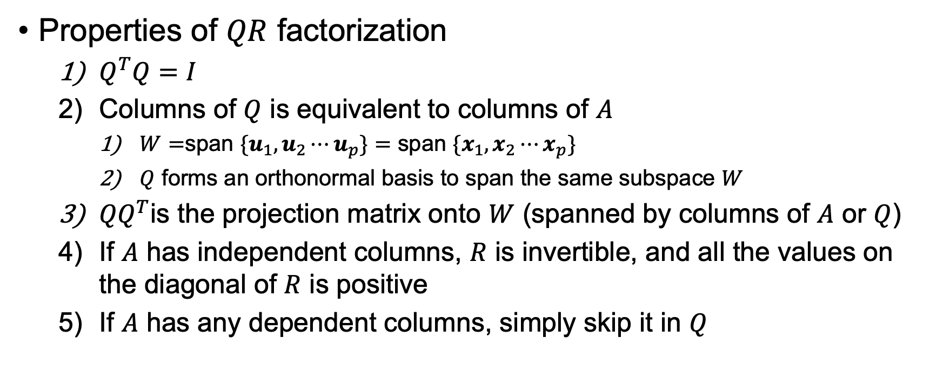
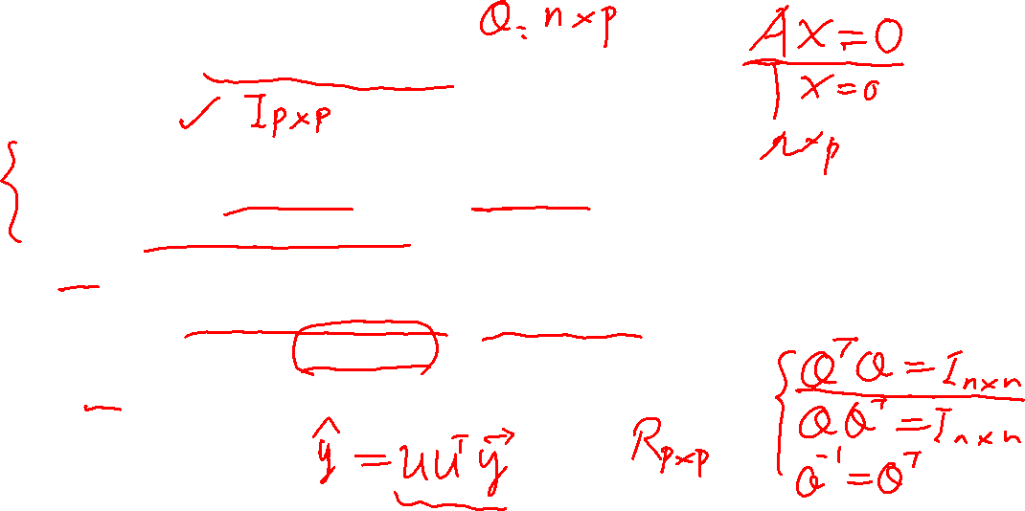
Key points – 6.3.2 QR Factorization Properties
Properties of $QR$ factorization
$Q^{T}Q=I$
Columns of $Q$ is equivalent to columns of $A$
$W=$span ${\{u}_{1},u_{2}⋯u_{p}\}=$ span ${\{x}_{1},x_{2}⋯x_{p}\}$
$Q$ forms an orthonormal basis to span the same subspace $W$
${QQ}^{T}$is the projection matrix onto $W$ (spanned by columns of $A$ or $Q$)
If $A$ has independent columns, $R$ is invertible, and all the values on the diagonal of $R$ is positive
If $A$ has any dependent columns, simply skip it in $Q$

Slide 21
End

